Slide 1
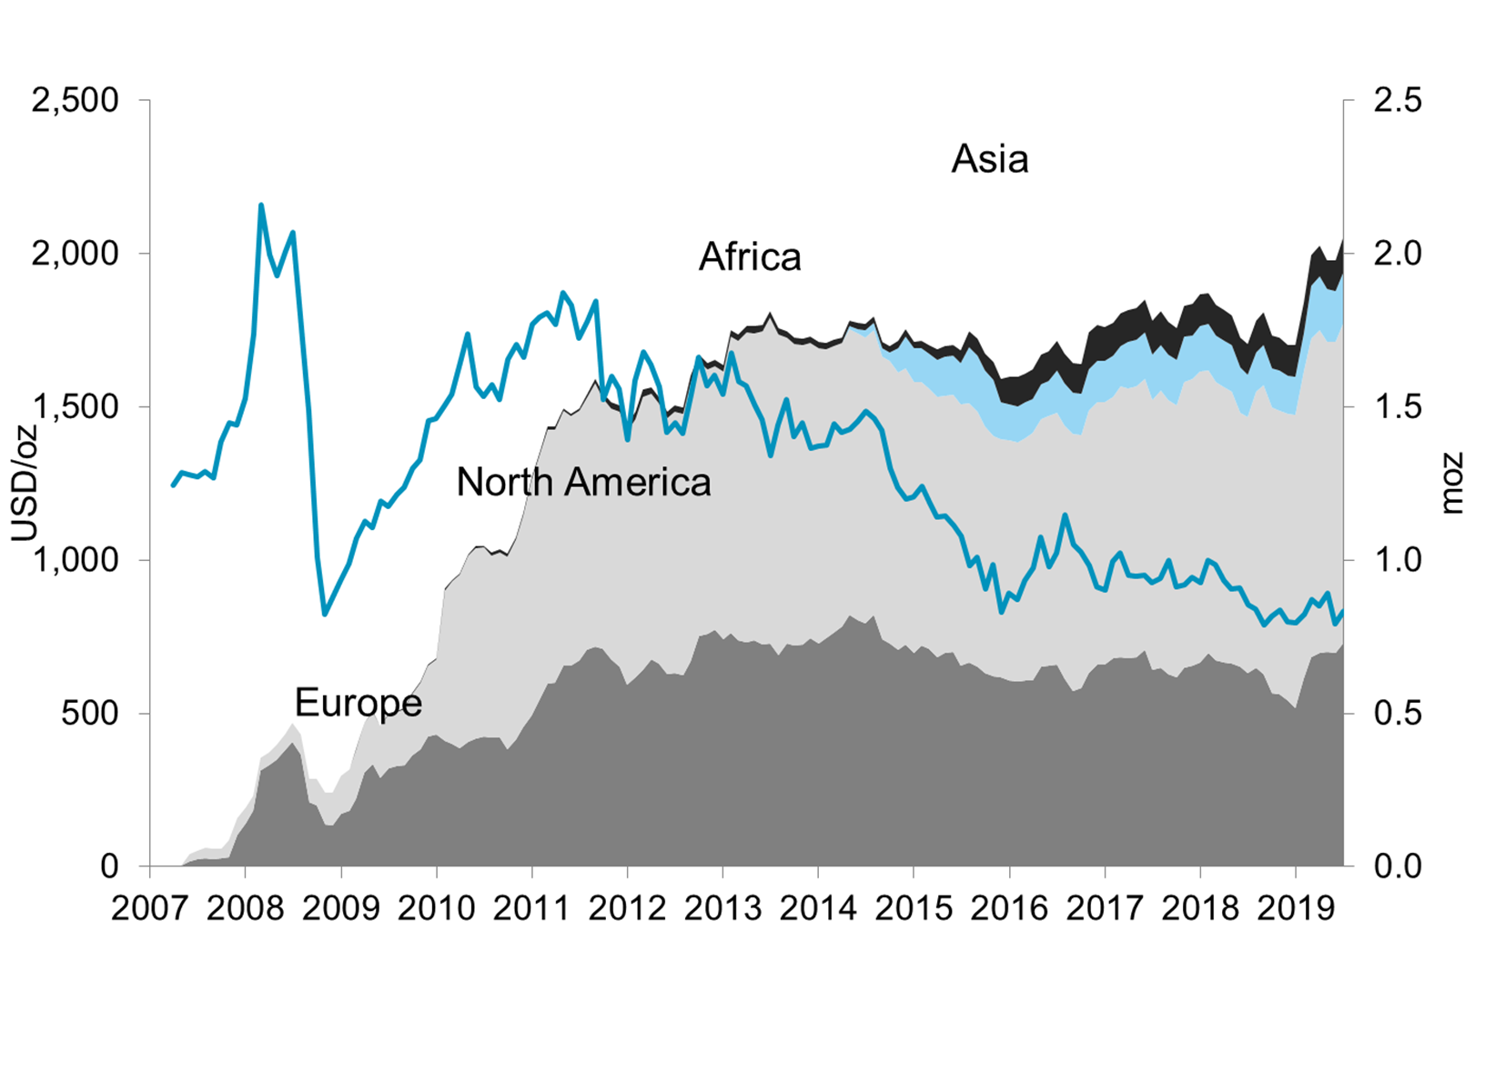
Etf holdings by region
Update: 30-June-2019

