Slide 1
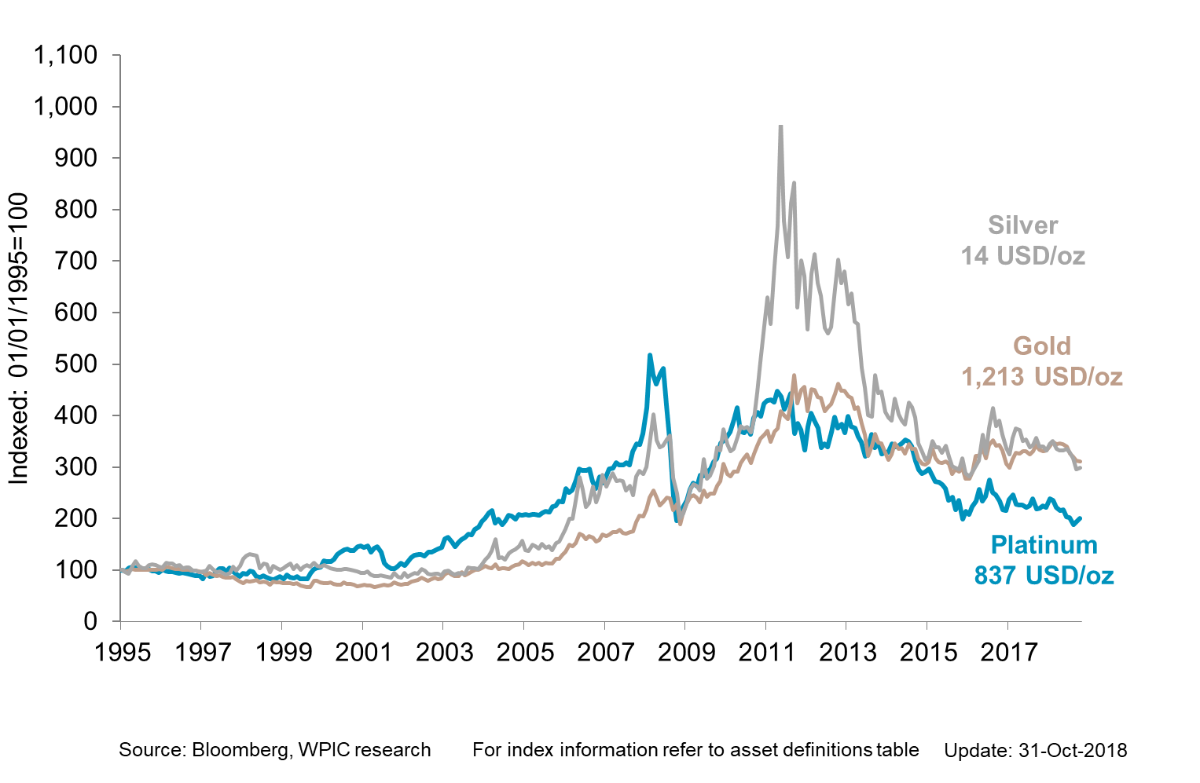
Precious metals performance since 1995

