Slide 1
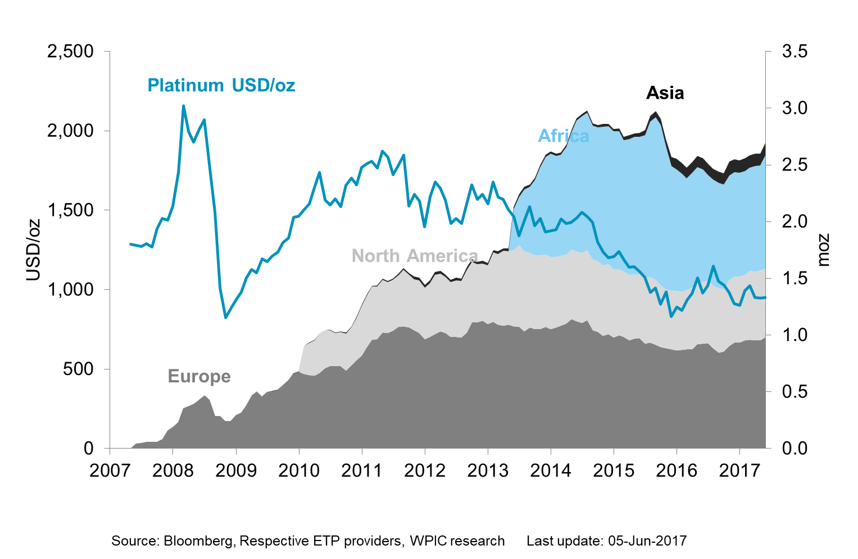
Etf holdings by region

